Slide 1
GROUNDWATER POLLUTION in Denmark
Notes:
Johan

Slide 2
Challenges
In Denmark the current quality of the groundwater allows humans to drink it almost without processing.
This is being threatened by pollution.
The government has issued regulations on the use of nitrate in farming.
We wish to test if these issued regulations have had the desired effect.
With an added emphasis on the differences between organic- and conventional farming.
Notes:
Emil

Slide 3
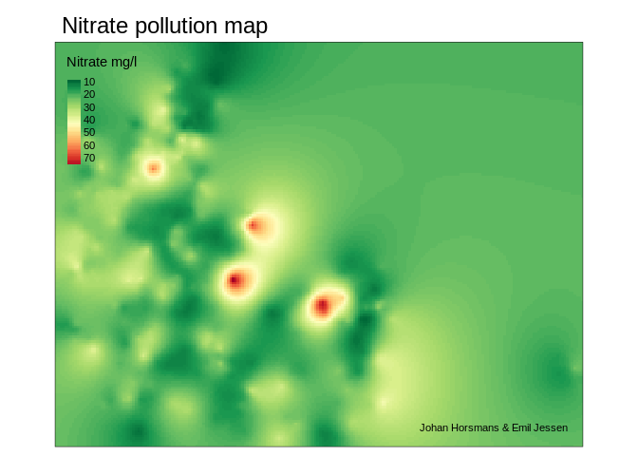
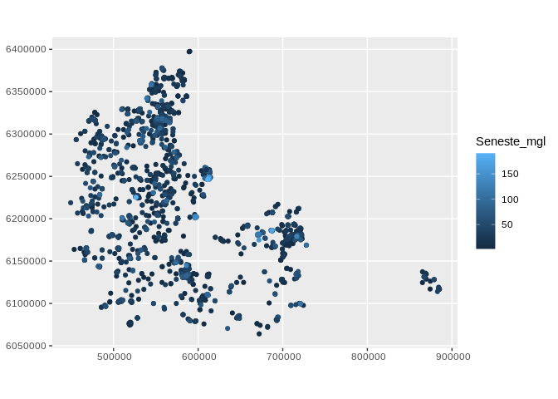
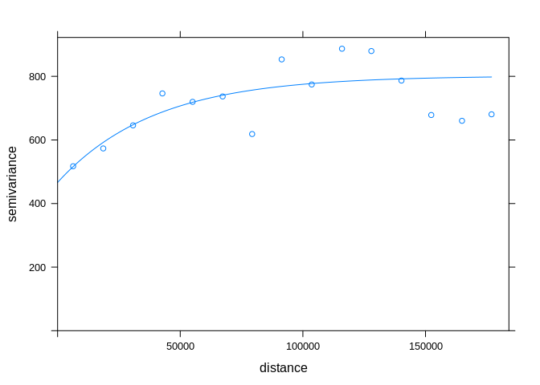
Our solution
Nitrate ~ land_type + intake_depth
Notes:
Johan

Slide 4
outcomes
By interpolating using kriging, we can infer nitrate pollution at locations without measurements.
We can calculate whether there is a significant difference in nitrate concentration between different types of land use.
Acknowledgements: Geological survey of Denmark and Greenland & Landbrugsstyrelsen.
Notes:
Emil

